Slide 1
Project Casper
Katz Group Canada Ltd.

Slide 2
Agenda
  Introductions
  McKesson Overview
  Katz Group / McKesson Canada Relationship
  Observed Best Practices
  Katz Group Operational Assessment
  Summary of Key Opportunities
  Proposed Next Steps

Slide 3
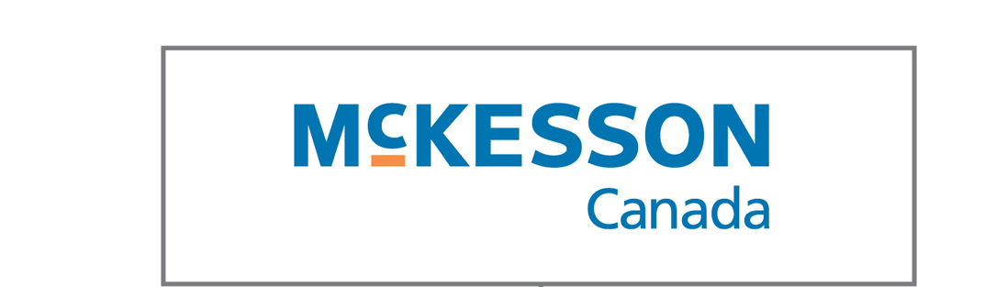
Introductions
Joe Varkul
VP / GM
Ontario Market Place
Graham Hardie
Director
Sales
Jeff Faria
Director
Operations
Doug Wilson
VP
Customer Solutions
Don Nicholson
KGC Account Manager
Promotions
Procurement
Logistics
Customer Service
Finance
IT / e-Commerce
Legal
HR
Automated Prescription Systems
Strategy & Business Development

Slide 4

McKesson Corporation Overview
McKesson Corporation is the leading provider of supply, information and health care management products and services in North America.
Ranked 20th of “Fortune 500”
30% N.A. market share (supply management)
22,000 employees
$50 Billion (USD) sales
Areas of expertise:
  Pharmacy distribution
  Medical-surgical distribution
  Management information solutions
  Inpatient/Outpatient pharmacy automation
  Health solutions

Slide 5

McKesson Canada Overview
McKesson Canada plays a key role in the Canadian economy and within the health care sector:
  Canadian head office (Montreal)
  Leading distributor in Canada
  1,900 employees
  Fifteen distribution centres
  Long term supply agreements
  Servicing over 7,000 community and hospital pharmacies
  Investment in the first automation robots for hospitals:
    Grand River Hospital, Kitchener
    Centre Hospitalier Affilié Universitaire de Québec

Slide 6
McKesson Canada Overview
McKesson
Pharmaceutical
McKesson
Outsource
Logistics
McKesson
Automation
McKesson
Information
Solutions
McKesson
Health
Solutions
Wholesale distribution of pharmaceutical and health-care products
Third-party logistics services to manufacturers including supply, marketing and distribution activities
Automated solutions to enhance pharmacy productivity and prescription dispensing accuracy
Comprehensive software solutions to improve information flow and decision-making
Products and services such as tele-health and nurse triage; focused on patent compliance and disease management
The result:
  Reduced costs
  Reduced medication errors and increased patient safety
  Enhanced quality of patient care

Slide 7
McKesson Canada Overview
Our Distribution Network
Edmonton
St.John’s
Vancouver
Winnipeg
Regina
Quebec
Calgary
Montreal
Moncton
St-Laurent
Brampton
Cornwall
Halifax
Full line
RxOTC
Frontshop
Outsource Logistics
Service Center
MOL
Ottawa
Mississauga

Slide 8
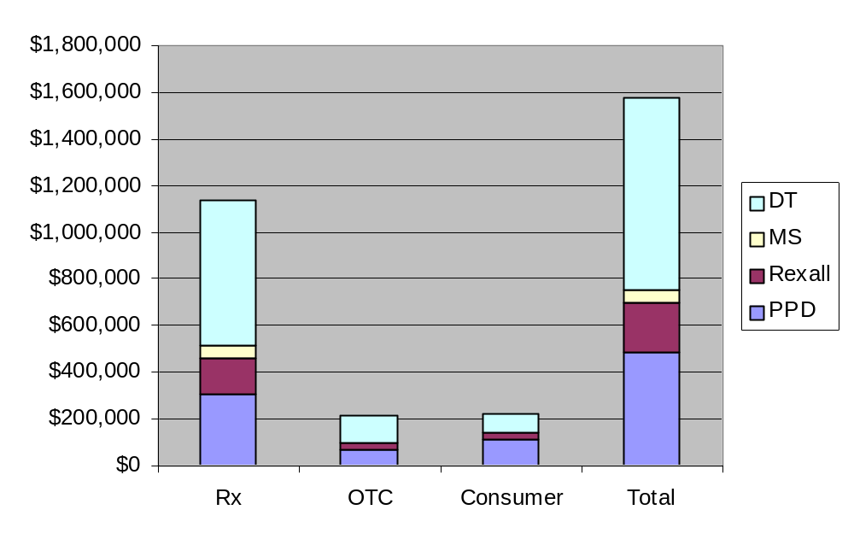
Katz Group / McKesson Canada Relationship
KGC Purchases by Class
April 1 – March 31 (01/02, 02/03)
Tightly integrated supply chain relationship
  Primary partner in Rx, OTC and Front Shop distribution
  High service levels
  Product listing flexibility
  Private label support
  Inventory system access
  Promotion process support
  Preferential routing design
  Manufacturer bill-back for promotional discounts
Source: McKesson Canada Purchase Data

Slide 9
Observed Best Practices
Automated Rx Inventory Replenishment
Automated Front Shop Inventory Replenishment
Electronic Order Management
Front-Shop Promotion Process Optimization
Dispensary Automation
Central Fill

Slide 10
Automated Rx Inventory Replenishment
Opportunity Description
Automated replenishment of dispensary inventory through the use of dispensary management software incorporating the required functionality
Reduction of manual intervention in day-to-day Rx inventory replenishment activities
Leverage of connectivity between KGC dispensary systems and McKesson Canada to electronically communicate replenishment orders, transmit invoices, and update inventory / pricing
KGC Current State
Of the KGC banners, Rexall is currently using auto-replenishment through the Kroll dispensary system
Other banners are currently using manual replenishment processes involving the Telxon ordering devices
Roll-out of the Nexxsys solution is underway throughout the KGC banners and will ultimately replace Kroll
The development of the auto-replenishment module for Nexxsys has commenced
Implementation Requirements
Business Impact
Standardization of dispensary management software (i.e., ProPharm Nexxsys)
Development and implementation of Nexxsys auto-replenishment functionality
Adoption of operating / system procedures to implement automated replenishment and leverage the McKesson electronic invoice file for store inventory and pricing update
Reduced Rx inventory, increased inventory turns
Reduced outdated product returns
Increased customer service levels
Redeployment of valuable dispensary resources to perform value-added services
Reduced reliance on casual staff for key ordering function

Slide 11
Automated Front Shop Inventory Replenishment
Opportunity Description
Automated replenishment of front shop inventory through the establishment of an electronic link between the store POS systems and McKesson Canada
Reduction of manual intervention in day-to-day front shop inventory replenishment activities
Leverage of connectivity between POS systems and McKesson Canada to electronically communicate replenishment orders, transmit invoices, and update inventory / pricing
KGC Current State
Front-shop inventory replenishment is primarily performed manually through the use of Telxon devices
Implementation Requirements
Business Impact
Auto replenishment functionality within store POS system
Adoption of operating / system procedures to implement automated replenishment
Change management / communication regarding store impact (e.g., benefits of auto replenishment), new procedures, roles and responsibilities
Improved in-stock inventory, increased revenues and improved customer service
Reduction in overall inventory levels
Reduction in over-stock returns
Redeployment of store managers to perform value-added functions related to category management, space management and customer service

Slide 12
Electronic Order Management
Opportunity Description
Internet-based order management to access product information, verify availability, place an order and receive confirmation, complete return transactions, manage back-orders, access special promotions, view purchasing history, and create valuable reports
McKesson Canada provides its customers with internet-based order management through its PharmaClik solution
KGC Current State
Drug Trading – 493 currently deployed, ongoing
Herbies – 11, fully deployed
Medicine Shoppe – 39 currently deployed, ongoing
Pharma Plus – 3 currently deployed (2 pilot, 1 DT)
  General roll-out June 6 in Ontario
  Expected completion by fall 2003
Rexall – 67 currently deployed, ongoing
Implementation Requirements
Business Impact
Drug Trading – enhanced performance possible through ProPharm VPN connectivity
Medicine Shoppe – VPN connectivity opportunity, issues related to minimum PC requirements
Pharma Plus – coordinating with ProPharm VPN scheduling
Rexall – concentrated deployment will continue following platform migration (i.e., Kroll to Nexxsys) and ProPharm VPN implementation
Improved ordering and order management efficiency
  Product information
  Real-time order confirmation
  Telxon / POS interface and order upload
  Back-order management
  Pre-booking orders and promotional list access
Purchase / invoice management & reporting
Reduced store inventory through POS integration
Increased customer service levels

Slide 13
Front Shop Promotion Process Optimization
Opportunity Description
Optimization of key promotional processes including:
  Item selection
  Pricing information
  Sales order form production
Transmission of promotional updates
Promotion order pre-booking compliance
KGC Current State
Current item selection process resulting in limited vendor order consolidation opportunities
Manual entry of pricing information into disparate systems increases likelihood and impact of errors
Current manual process for production of sales order forms for pre-books reduces promotional efficiency
Information required to update promotions is manually re-keyed into McKesson’s systems
Stores are not accurately pre-booking promotional orders resulting in lost sales and reduced service levels, or excessive inventories
Implementation Requirements
Business Impact
Focus on cross-banner promotional forecasting to increase vendor order consolidation opportunities
Integrate systems to reduce instances of pricing discrepancies, and establish electronic link
Automate production of pre-book sales order forms
Automate transmission of promotion update info
Establish processes to optimize pre-booking and create incentives to increase store compliance
Increased in-stock promotional inventory, increased sales, and increased customer service levels
Improved promotional process efficiency
  Reduced manual intervention through increased automation
  Reduced file maintenance requirements
  Reduced errors and associated verification, re-work / correction

Slide 14
Dispensary Automation
Opportunity Description
Automation of pharmacy functions through:
  Counting technologies
  Water dispensers
  Systems & work flow management solutions
  Robotics
KGC Current State
The implementation of counting technologies is currently underway within some banners
  177 Baker Universal scales
  7 Baker Cell Systems (2 at Medi-Trust)
  1 Autoscript III Robot
  117 Dial Rx IVR (in PPD stores) - an additional 19 systems are scheduled for immediate rollout
Implementation Requirements
Business Impact
Pharmacist acceptance
Modification of workflow processes
Minimal space and script count requirements
Reduced labour costs and re-deployment of skilled resources to value added functions (e.g., cognitive services)
Minimize impact of pharmacist and technician labour shortage
Reduced error rates
Increased fulfillment speed leading to improved customer service

Slide 15
Central Fill
Opportunity Description
Centralized prescription fulfillment where prescriptions are assembled, verified, packaged and delivered back to local pharmacy
Prescription data entry and delivery to the customer is done at the local store
Suitable for both refills (up to 50+% of in-store prescriptions) and new prescriptions
KGC Current State
Within the Katz Group, prescriptions are filled within the local pharmacy
MEDITrust currently employs automated prescription technologies to support its national mail-order pharmacy business. The centralized facilities and automation in use within MEDITrust could serve as the foundation for an expanded central fill capability
Implementation Requirements
Business Impact
Favourable legislation (currently only B.C.)
Decision re: central fill models:
  Customer Owned
  Transaction Fee Model
  Hybrid
Pharmacy connectivity to Central Fill Host
Central fill facility development (i.e., automation)
Reduced pharmacy workload
Reduced impact of pharmacist & technician shortage
Reduced customer wait time
Reduced labour cost / Rx and flattened cost growth
Reduced store inventory
Increased quality assurance
Increased store prescription capacity levels

Slide 16
Positioning of Opportunities
Business Impact
Opportunity
Proposed
Timeframe*
Ease of
Implementation
Increased
Revenue
Reduced
Inventory
Improved
Service
Increased
Efficiency
Automated Rx Inventory Replenishment
Q4
Automated Front Shop Inventory Replenishment
2004
Electronic Order Management
Q2-Q4
Front Shop Promotion Process Optimization
Q2-Q4
Dispensary Automation
Ongoing
Central Fill
2004+
* Proposed timeframe based on calendar year
Legend:
Low
High

Slide 17
Proposed Next Steps
Obtain KGC feedback re: opportunities, priorities and timelines
Adjust current initiatives to reflect priorities and timelines
Identify appropriate McKesson Canada involvement in Casper Project team
Participate in project plan development and execution for the Design and Implementation phases of the project

